Slide 1
The Math Class
AP Computer Science A

Slide 2
Math in Java
The Math (java.lang.Math) class provides basically all of the mathematical functions you will need in Java. These functions include, absolute value, square root, trig functions, log functions, exponential functions, and more.
The Math class also contains the constant doubles Math.PI and Math.E for pi and Euler’s number. These are approximations with double point precision.

Slide 3
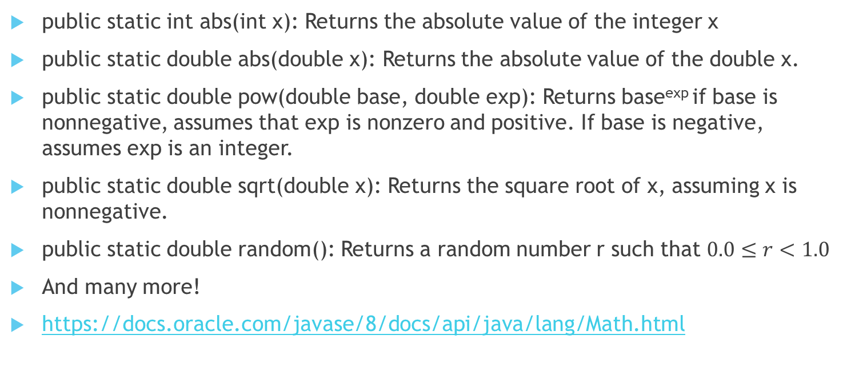
Some Math Class Methods
public static int abs(int x): Returns the absolute value of the integer x
public static double abs(double x): Returns the absolute value of the double x.
public static double pow(double base, double exp): Returns base^{exp} if base is nonnegative, assumes that exp is nonzero and positive. If base is negative, assumes exp is an integer.
public static double sqrt(double x): Returns the square root of x, assuming x is nonnegative.
public static double random(): Returns a random number r such that $0.0≤r<1.0$
And many more!
https://docs.oracle.com/javase/8/docs/api/java/lang/Math.html

Slide 4
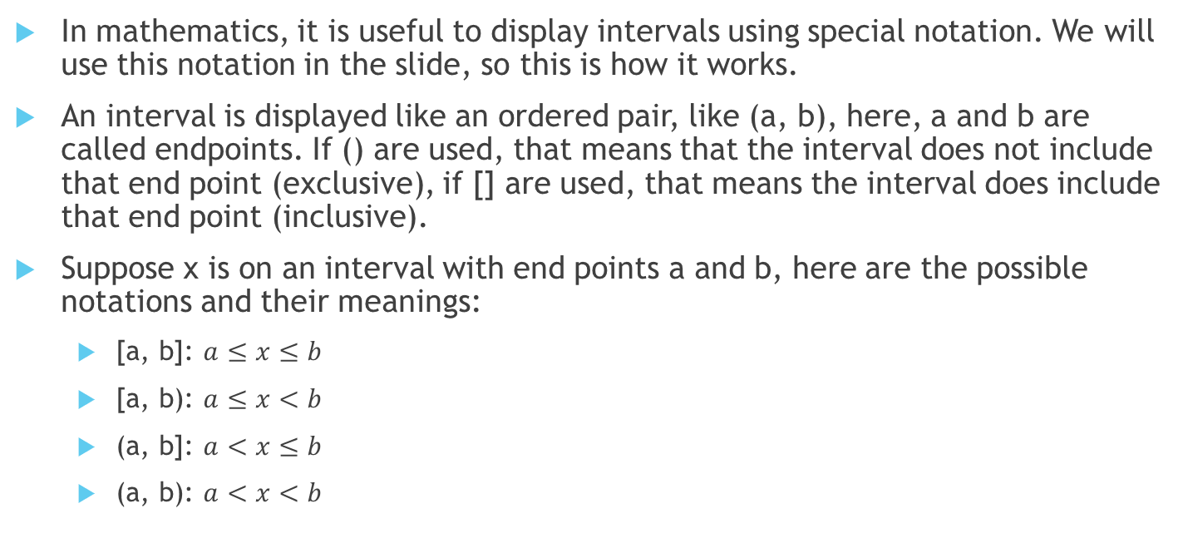
Interval Notation
In mathematics, it is useful to display intervals using special notation. We will use this notation in the slide, so this is how it works.
An interval is displayed like an ordered pair, like (a, b), here, a and b are called endpoints. If () are used, that means that the interval does not include that end point (exclusive), if [] are used, that means the interval does include that end point (inclusive).
Suppose x is on an interval with end points a and b, here are the possible notations and their meanings:
[a, b]: $a≤x≤b$
[a, b): $a≤x<b$
(a, b]: $a<x≤b$
(a, b): $a<x<b$

Slide 5
Random Real Numbers
Recall that Math.random() returns a random number on interval [0.0, 1.0).
Suppose we want to return values with a custom interval. Here are some ways to do that:
On interval [0.0, b):
double x = b * Math.random();
On interval [a, a + 1.0):
double x = Math.random() + a
On interval [a, b):
double x = (b – a) * Math.random() + a

Slide 6
Random Integer Numbers
Casting the results of a scaled Math.random() to an integer is a good way to generate random integers. Below are examples on how to produce different ranges:
On interval [0, b):
int n = (int) (Math.random() * b);
On interval [a, b):
int n = (int) ((b - a) * Math.random()) + a;
On interval [a, b]:
int n = (int) ((b – a + 1) * Math.random()) + a;

Slide 7

Any Questions?

